Slide 1

Project Title -
Seasonal Agriculture Performance Analysis
Student Name : Jonada Tejas
College Name : St. Joseph Degree and PG College
AICTE STU ID : STU69999fc96409f1771675593

Slide 2

PROBLEM STATEMENT
- Agricultural performance varies across seasons because of differences in environmental conditions, farming practices, resource availability, and market conditions.
However, raw agricultural data does not clearly show:
How agricultural performance changes across seasons
Which seasons perform better economically
How environmental conditions relate to agricultural outcomes
How resource usage differs between seasons
Which crops and irrigation methods perform better
Whether seasonal patterns remain consistent across regions

Slide 3
Project Description
This project performs an end-to-end exploratory data analysis of 4,000 agricultural farm records containing 28 variables.
The dataset contains information related to:
- Crop and season, State and district, Farm area, Rainfall, temperature, Humidity, soil conditions
Fertilizer, pesticide usage, Irrigation method, Yield, production, Market price, Production cost
Revenue, profit, Water usage, water efficiency, Disease and pest risk
Analysis Process
Data Loading → Data Cleaning → Statistical Analysis → Visualization → Seasonal Comparison → Relationship Analysis → Student-Designed Analysis → Insights → Recommendations
Main Objective
To understand why agricultural performance differs across seasons and identify patterns that can support better seasonal agricultural planning.

Slide 4

WHO ARE THE END USERS?
Farmers
- To understand seasonal profitability, crop performance, water usage, and resource efficiency.
Agricultural Planners
- To compare seasonal and regional agricultural performance for planning and resource allocation.
Agricultural Extension Officers
- To identify areas where farmers may require better seasonal planning or resource-management guidance.
Researchers & Data Analysts
- To study relationships between environmental conditions, farming practices, resource usage, and agricultural outcomes.
Educational Institutions
- To demonstrate how real-world agricultural datasets can be analyzed using data analytics techniques.

Slide 5

Technology Used
Technology | Purpose
Python | Core analysis
Pandas | Data manipulation & analysis
Numpy | Numerical operations
Matplotlib | Data visualization
Seaborn | Statistical visualization

Slide 6
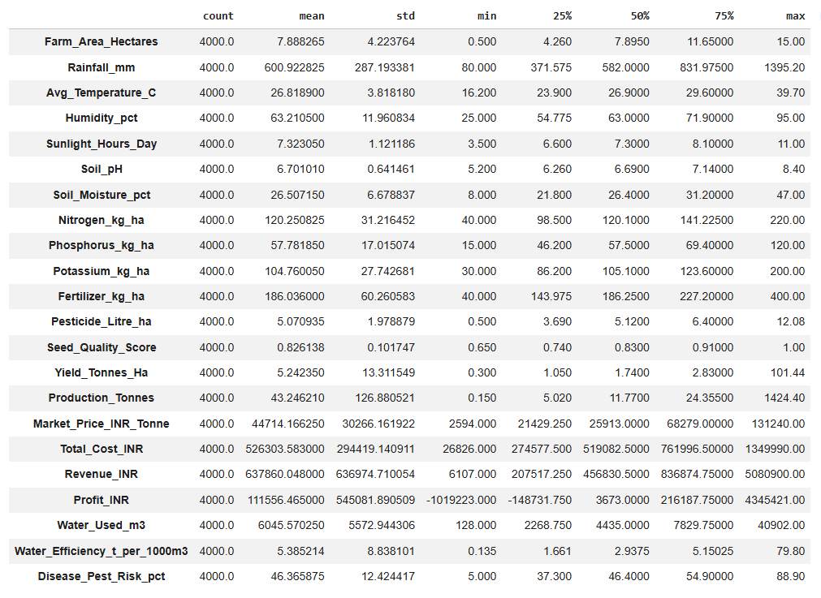
RESULTS
Descriptive analysis table -

Slide 7
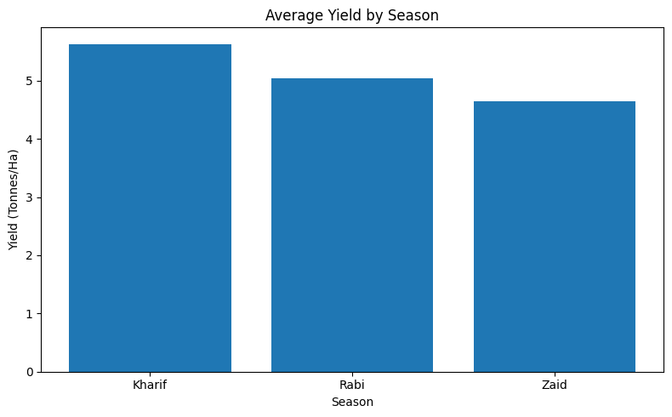
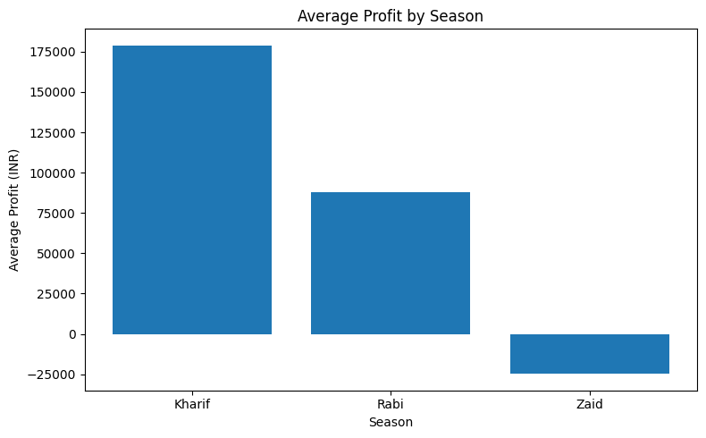
RESULTS
Average profit changes from approximately:
₹178.9K → ₹87.7K → -₹24.8K
from Kharif → Rabi → Zaid.

Slide 8
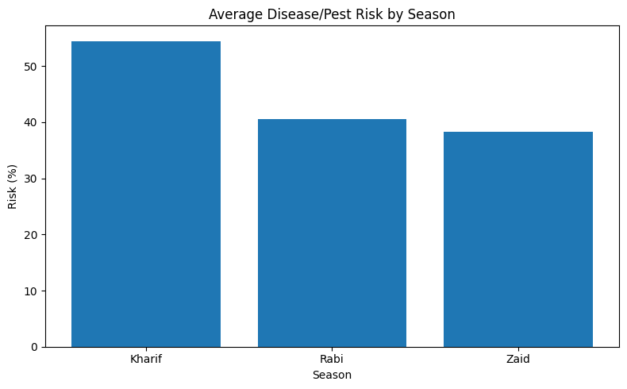
RESULTS
Zaid uses the most water on average but produces the lowest average yield.
Kharif has the highest average water efficiency.
Kharif also shows the highest average disease/pest risk.
Resource usage and agricultural performance should therefore be evaluated together rather than separately.

Slide 9
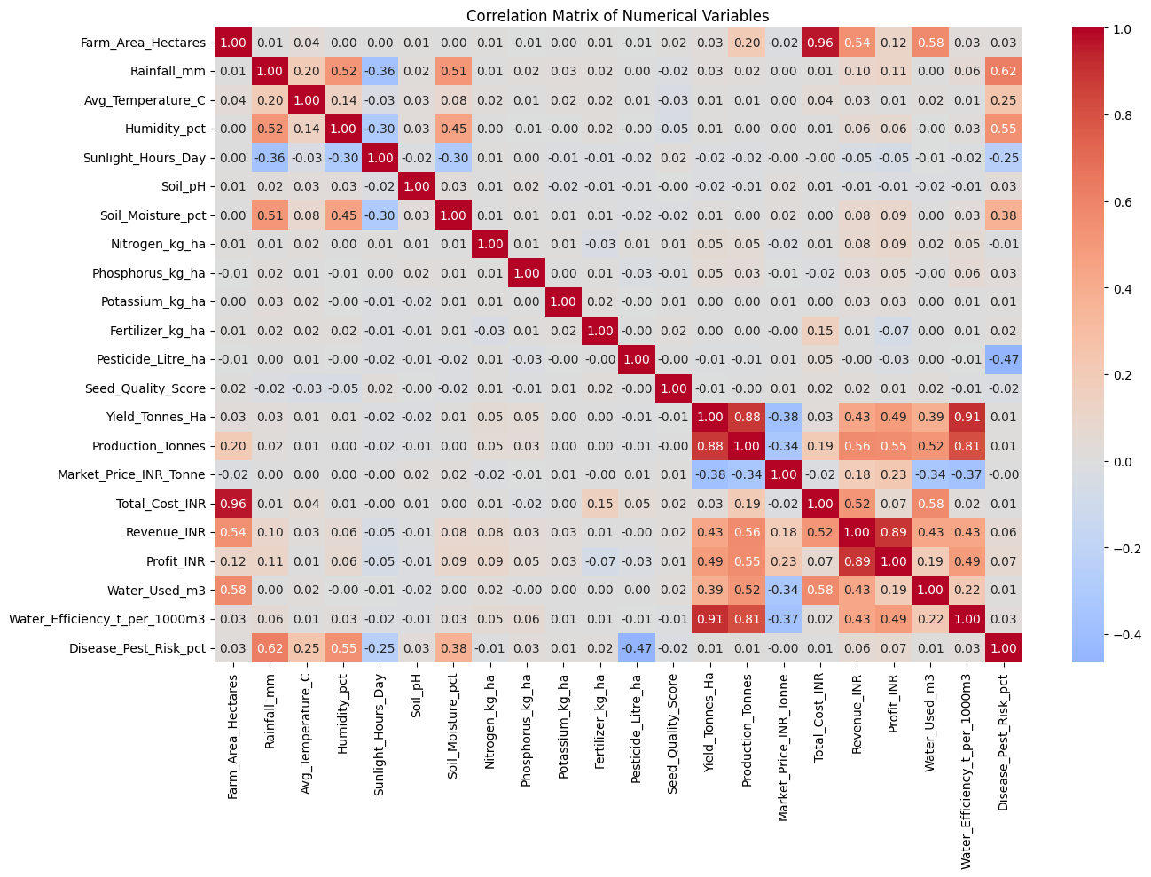
RESULTS
Sugarcane has the highest average profit in the dataset.
Chilli is the second-highest average-profit crop.
Wheat has the lowest average profit.
Drip irrigation has the highest average yield and average profit among the irrigation methods.
Flood irrigation has the highest water consumption.
Irrigation efficiency cannot be judged using water consumption alone; yield and profit must also be considered.

Slide 10
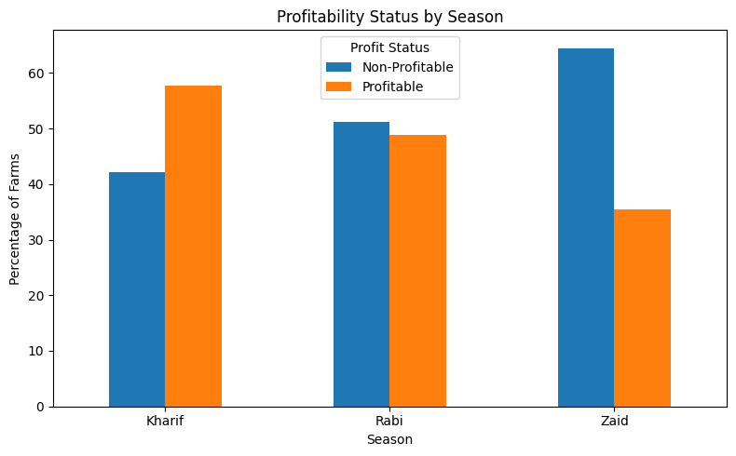
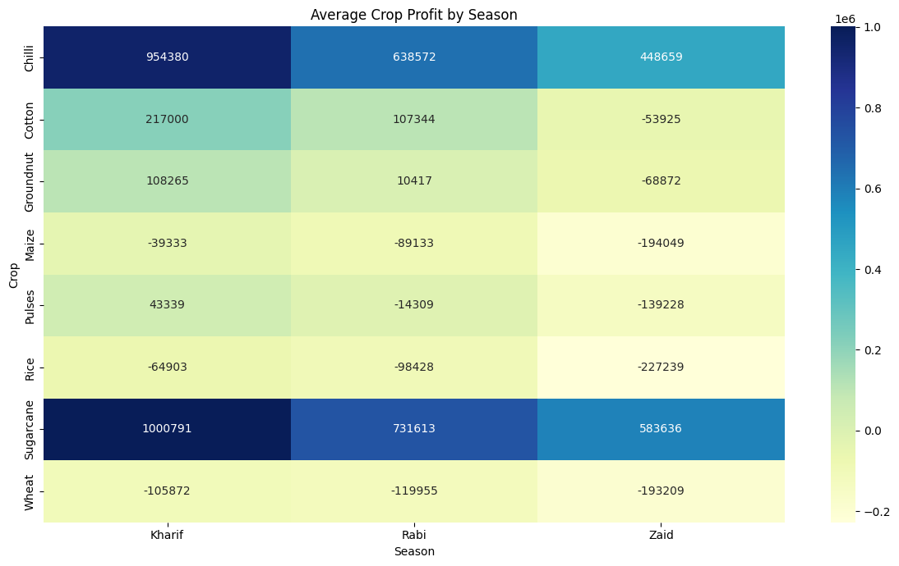
RESULTS
Drip irrigation provides the strongest combined performance, while flood irrigation uses substantially more water.
Crop performance changes across seasons, indicating that crop selection should consider seasonal conditions rather than overall crop averages alone
Average profit differs considerably between states, indicating regional variation in agricultural performance.

Slide 11
Future scope
1. Predictive Modelling
-Develop machine learning models to predict:
Crop yield, Farm profitability, Disease/pest risk, Water requirement
2. Weather Integration
- Combine real-time and historical weather information with agricultural records.
3. Crop Recommendation
- Develop a recommendation system that considers season, environmental conditions, profitability, and resource availability.
4. Regional Decision Support
- Create region-specific agricultural performance dashboards.
5. Time-Series Analysis
- Use multiple years of agricultural data to identify long-term seasonal trends.

Slide 12
GitHub Link
https://github.com/JONADA-TEJAS/Seasonal-Agricultural-Performance-Analysis

Slide 13
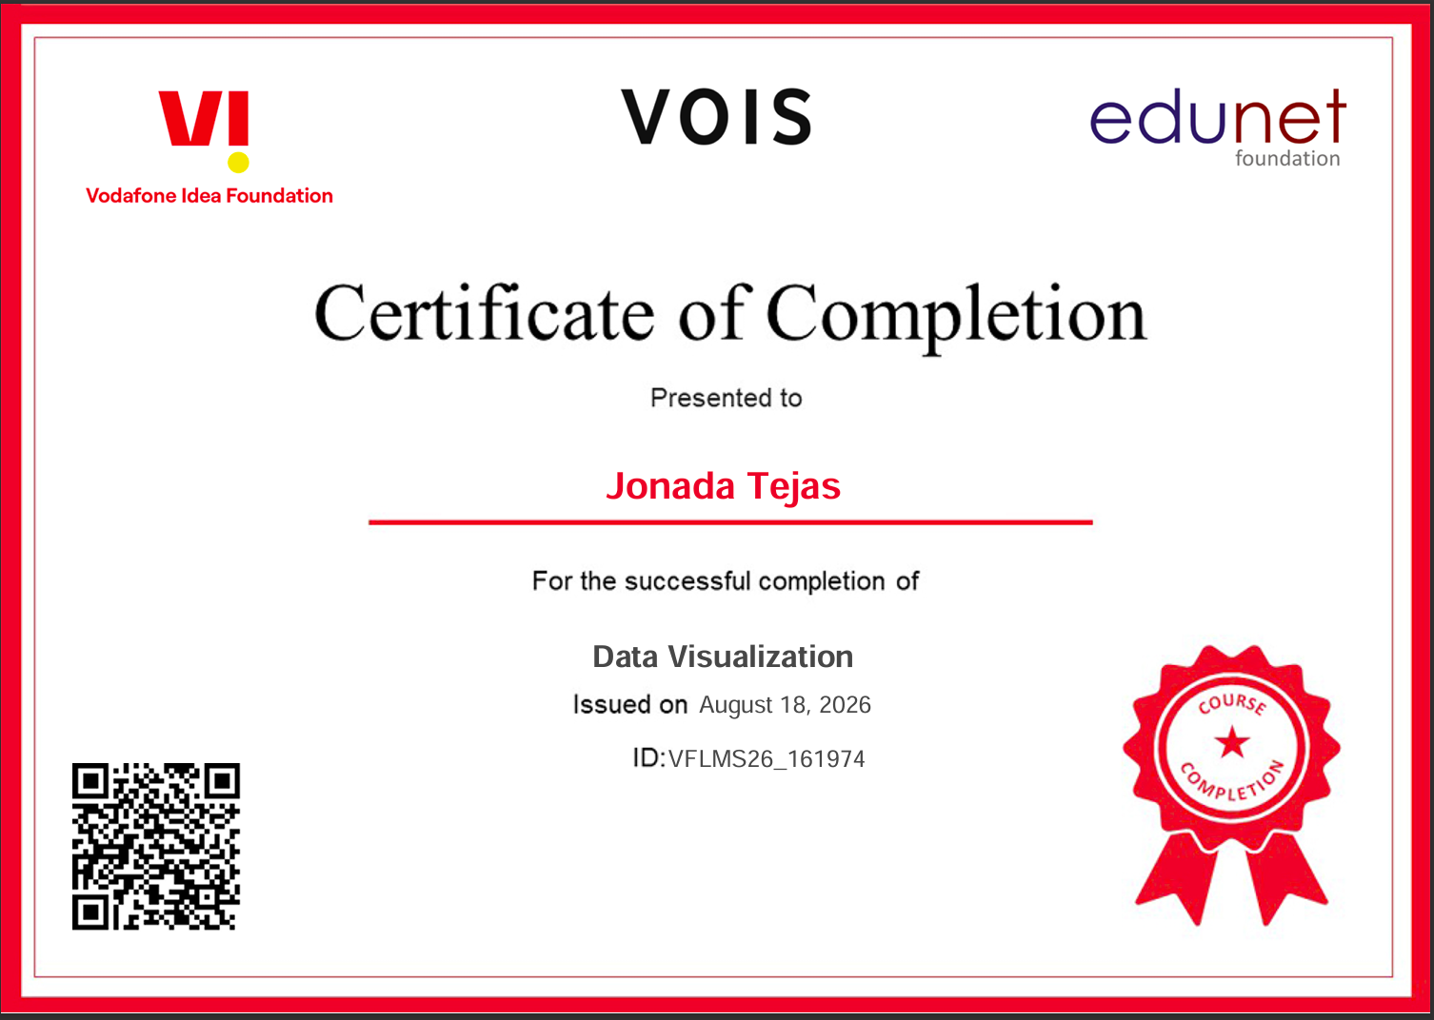
VOIS Course completion certificate - Course name- Data Visualization

Slide 14
Thank you
.
.

